Slide 1
Michael Vick
Created By: Samuel Perovsek

Slide 2
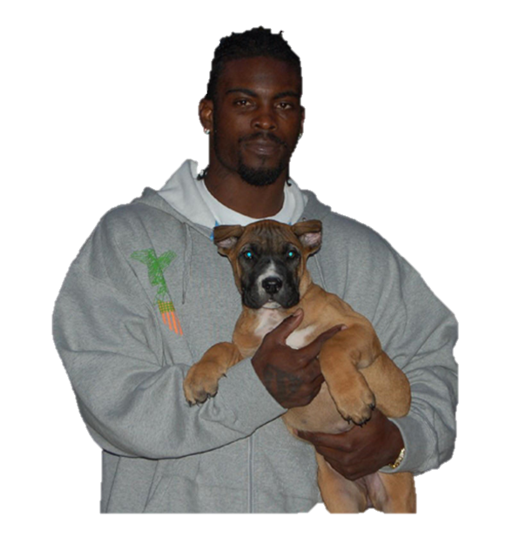
“I knew the magnitude of the decision that I made, and the poor judgment, and what I allowed to happen to the animals.”- Michael Vick
Notes:
Michael Vick made a mistake just as all of us do in our lives. He worked hard to move past all the wrongs he had done. To judge someone’s life based on one mistake they made would be wrong, and just unfair.

Slide 3
Born on June 26, 1980 in Newport News, Virginia
Notes:
New port News has over 180,000 people. It is located along the Chesapeake Bay. Vick grew up in a very tough area, with drug and gang life. Vick was the second of four children, and was athletically gifted from the start.

Slide 4
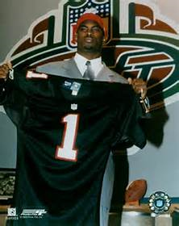
Michael Vick was taken with the first pick in the NFL Draft by the Atlanta Falcons
Notes:
Vick by passed his final two years of college and entered the NFL draft as a sophomore. Drafted from The Virginia Tech Hokies. Vick was the First African American Quarterback to be picked number 1 overall. After his rookie season he was given a 10 year 130 million dollar contract.

Slide 5
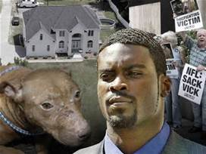
April 25, 2007 arrested for dog fighting
Notes:
Vick had a ring of 50 pit bulls he trained, and when they showed no promise he would kill them by hanging, drowning, or beating. He would bet $26,000 for each fight. Vick had pits set up in his backyard that were covered in blood stains from the dogs. He was sentenced to almost two years in prison. This moment was a very major setback in his career.

Slide 6
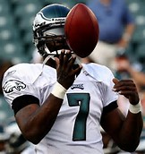
In 2011 he threw for over 3,300 yards with the Philadelphia Eagles
Notes:
Vick was named comeback player of the year. Admitted his faults and was dedicated to achieving success. Michael Vick could have very easily lied down and admitted defeat when he was arrested. He fought to be back where he was to start.

Slide 7
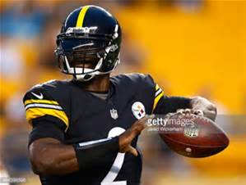
Currently plays for the Pittsburgh Steelers
Notes:
The Steelers are in the AFC Central. He is currently a back up quarterback to Ben Roethlisberger. He hasn’t played in very many games this year because Ben Roethlisberger is one of the best quarterbacks in the NFL.

